Slide 1





A BI Capstone project on CRM Analytics

Slide 2


Report Analytics & Dashboard Analytics for Stake-Holders
01
Opportunity
06
02
05
Lead
04
03

Slide 3
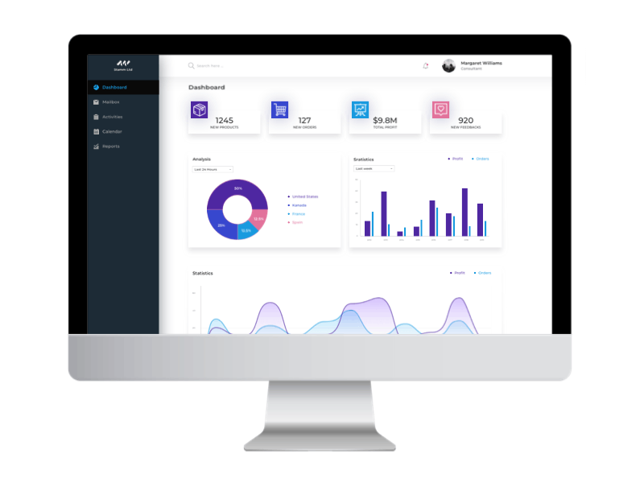
Project Steps for CRM Data Analysis
Tools Used: Excel, Tableau, Power BI, MY SQL.
Step-by-Step Workflow:
Excel Dashboard: Create an initial dashboard using provided Excel data.
SQL Integration: Load files into a SQL database under a Supply Chain data schema.
BI Tool Connection: Connect SQL database to Tableau/Power BI and create a data model with necessary joins.
Dashboard Development: Build interactive dashboards in Tableau and Power BI.
Quality Assurance (QA): Validate data by comparing database records with dashboards to ensure accuracy.
Final Presentation : Create Final Presentation and Present with PPT order
1-Group Details
2-Summary about the Project
3-KPI List
4-Excel Dashboard
5-Tableau Dashboard
6-Power BI Dashboard
7-SQL Query Image
8-Key Takeaway

Slide 4
Report Analytics & Dashboard Analytics for Stake-Holders
Opportunity Dashboard
Expected Amount
Active Opportunities-Total count of open opportunities.
Conversion Rate-Conversion Rate (%)=(Closed Won Opportunities/Total Opportunities​)×100
Win Rate-Win Rate (%)=(Closed Won Opportunities/Total Opportunities​)×100
Loss Rate-Loss Rate (%)=(Closed Lost Opportunities/Total Opportunities​)×100
Trend Analysis
Expected Vs Forecast: Running total comparison of expected revenue and forecast over time.
Active Vs Total Opportunities: Cumulative active vs. total opportunities trend.
Closed Won Vs Total Opportunities: Track closed-won deals against total opportunities.
Closed Won Vs Total Closed: Analyze closed-won deals compared to all closed deals.
Expected Amount by Opportunity Type
Opportunities by Industry

Slide 5
Report Analytics & Dashboard Analytics for Stake-Holders
Lead Dashboard
Total Lead
Expected Amount from Converted Leads
Conversion Rate-Conversion Rate (%)=(Leads Converted to Customers/Total Lead​)×100
Converted Accounts
Converted Opportunities
Lead By Source
Lead By industry
Lead by Stage

Slide 6
Date | Time | Task Description
18-01-2025 | 8 AM – 9 AM | Project Kick-off Meeting
25-01-2025 | 8 AM – 9 AM | Implementation of KPI’s using Excel
01-02-2025 | 8 AM – 9 AM | Implementation of KPI’s using Tableau - SQL
08-02-2025 | 8 AM – 9 AM | Implementation of KPI’s using Power BI – SQL
15-02-2025 | 8 AM – 9 AM | Final Presentation of the Project

